Slide 1
CSBC Breast Cancer Overview
Andrea Bild, Ph.D.
Professor, Medical Oncology and Therapeutics
City of Hope
abild@coh.org

Slide 2
Objectives
Breast cancer review.
Understand different genomic mechanisms that lead to aberrant signal transduction, including gene amplification/deletion, activating mutations and mutations that inhibit protein function.
Understand that molecular and genetic alterations in tumors are prognostic, diagnostic, and can be used in therapy decisions for patients.
Understand confounding factors in genomic analyses.

Slide 3
Breast Cancer Overview

Slide 4
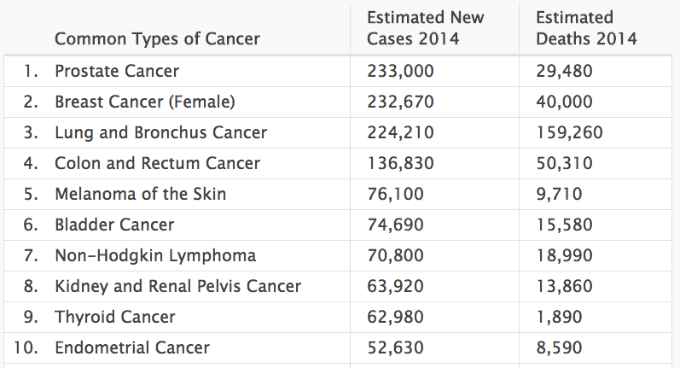
Most Common Cancer Types in U.S.
Source: http://seer.cancer.gov/statfacts

Slide 5
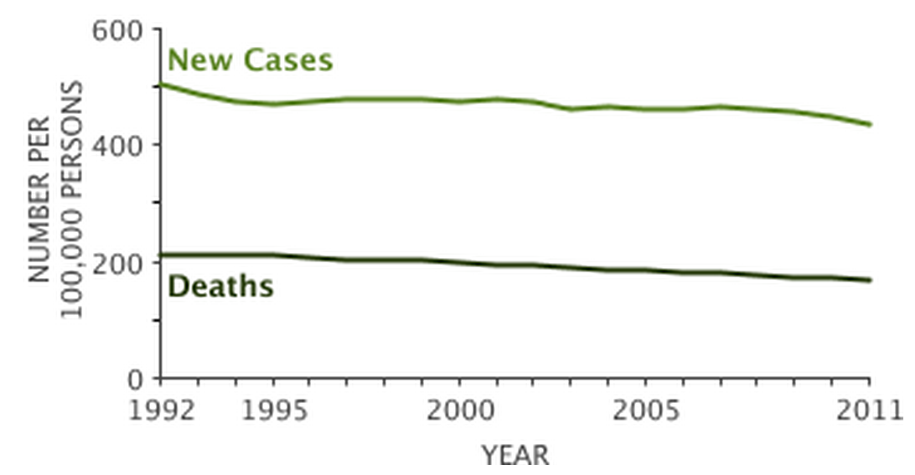
The Situation Is Getting Better…Gradually
Current Progress in Cancer Diagnosis and Treatment
Source: http://seer.cancer.gov/statfacts

Slide 6
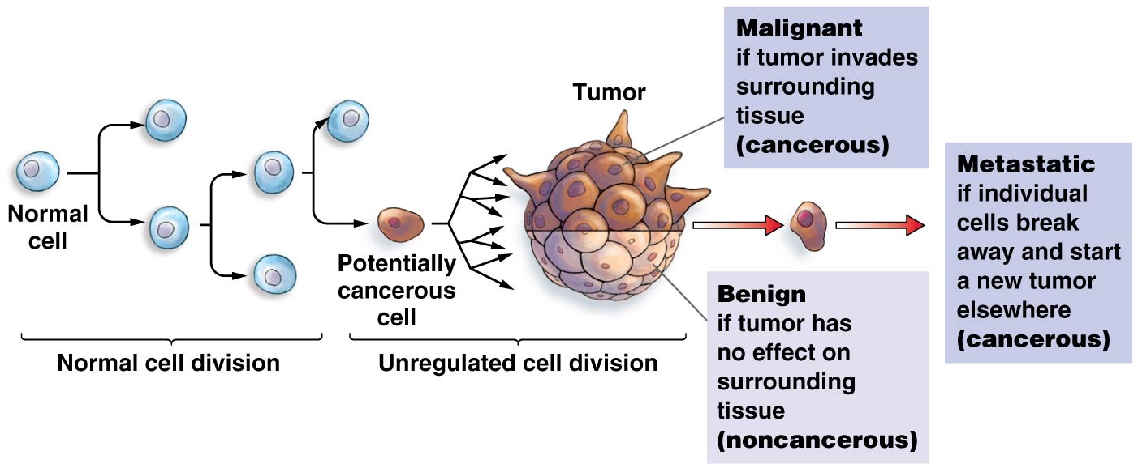
How do tumors develop?

Slide 7
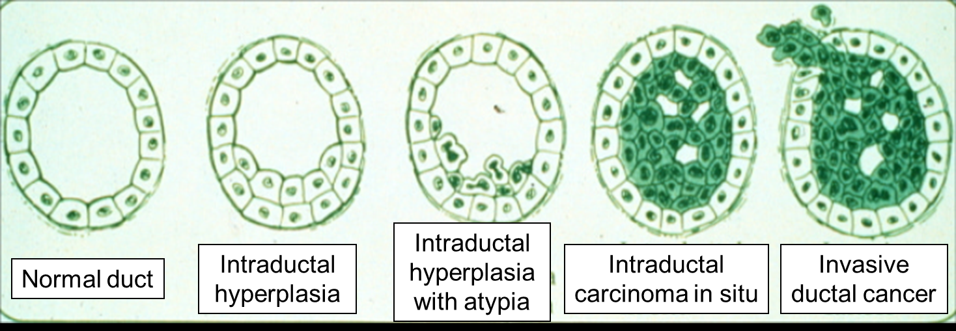
Breast Cancer Development
5 year survival:
Stage 1: 95-100%
Stage 2: 86%
Stage 3: 57%
Stage 4: 20%
BUMC.org

Slide 8
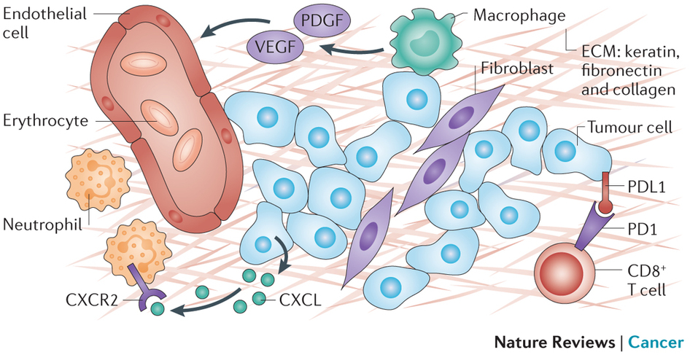
Tumor Composition
Nature Reviews Cancer 14, 535–546 (2014)

Slide 9
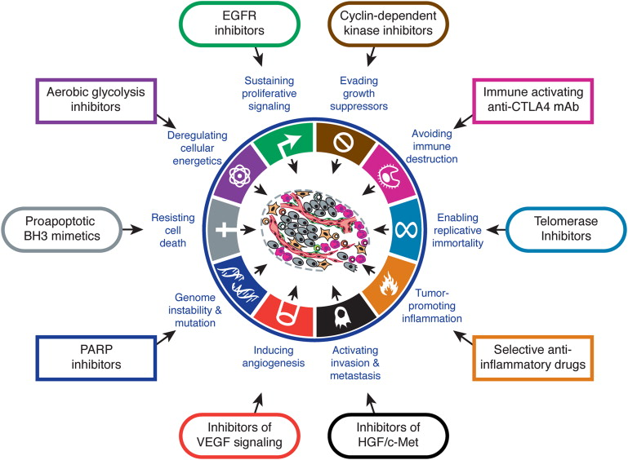
Hallmarks of Cancer
Hanahan and Weinburg, Cell, Volume 144, Issue 5, p646–674, 4 March 2011

Slide 10
Oncogenic Signaling Overview

Slide 11

Proto-oncogene
https://giphy.com/embed/ypJDAUdeiBZDy" width="480" height="192" frameBorder="0" class="giphy-embed" allowFullScreen></iframe><p><a href=https://giphy.com/gifs/ypJDAUdeiBZDy

Slide 12

Oncogene

Slide 13

Tumor suppressor gene
Courtesy: http://www.tbo.com/news/education/crossing-guards-hit-the-streets-for-start-of-school-20150823/

Slide 14
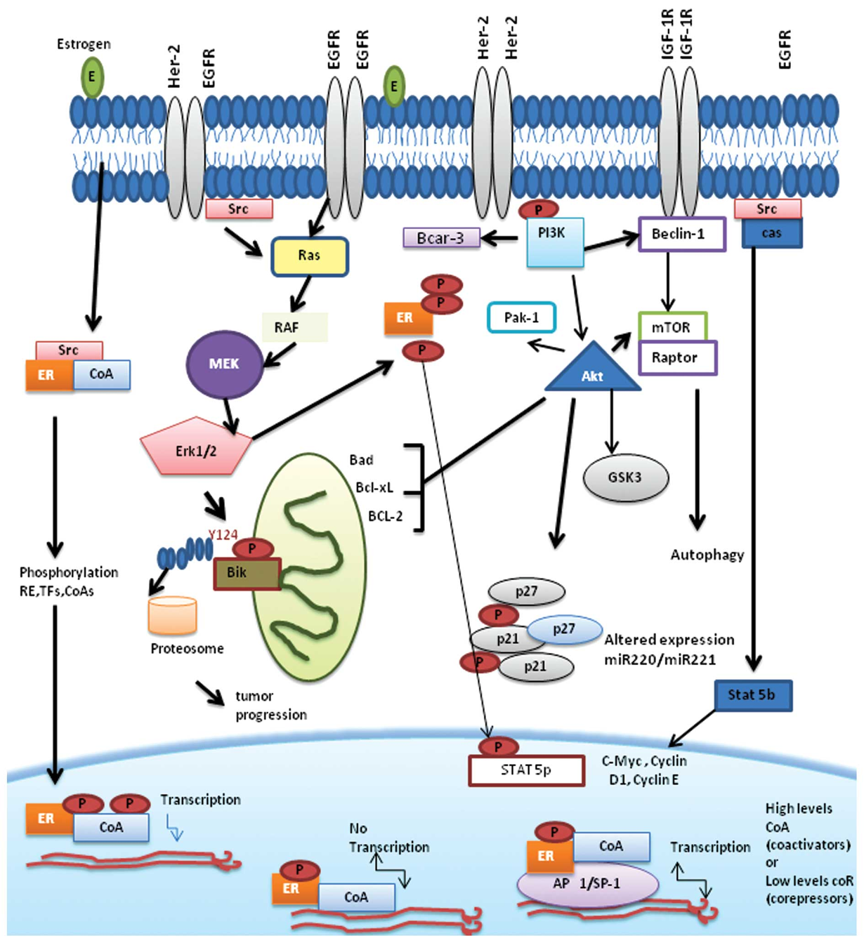
Oncogenic Signaling in Breast Cancer

Slide 15
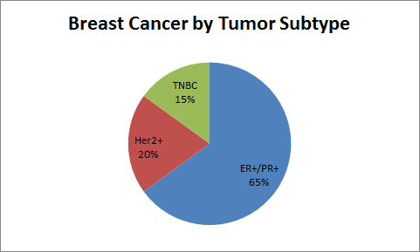
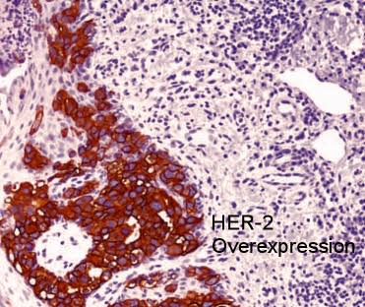
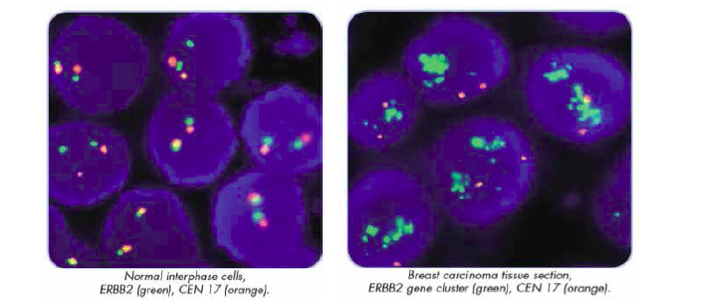
Her2 amplification

Slide 16
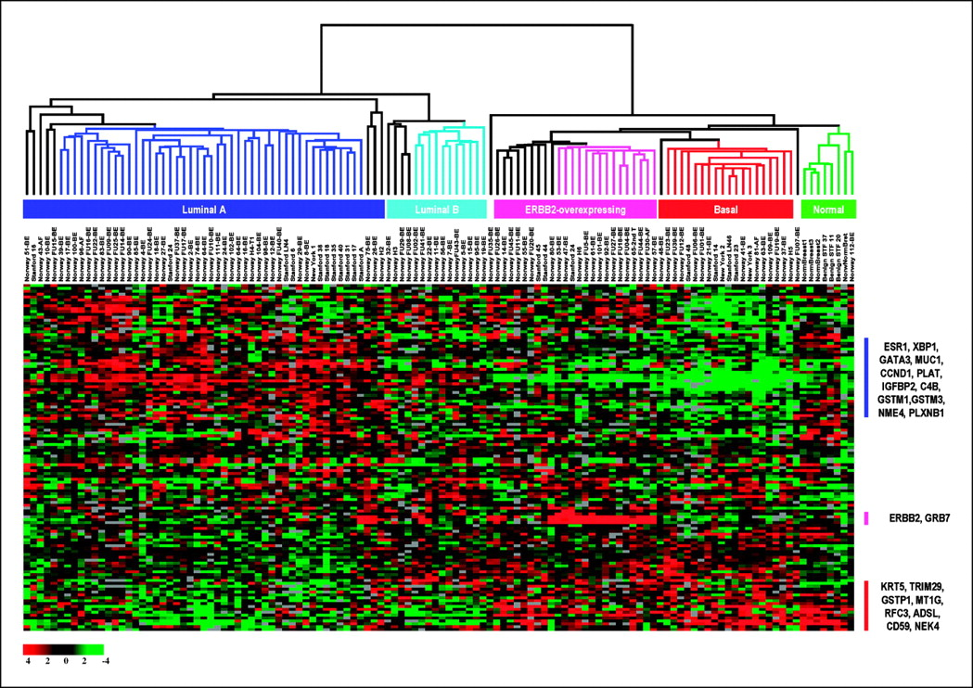
Molecular Cancer Subtypes—Breast Cancer

Slide 17
Question:
What are some of the consequences of HER2 amplification in a tumor?

Slide 18





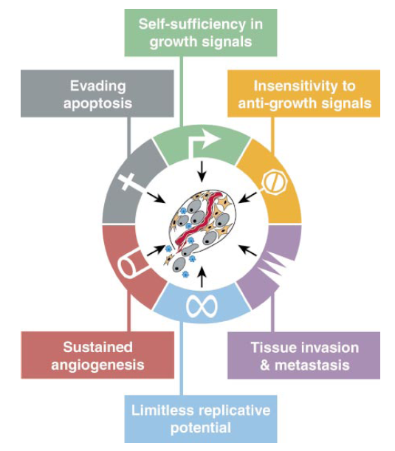




Oncogenic Signaling in Breast Cancer-an example
Ligand / Growth Factor
Receptor
Negative Feedback
Cytoplasmic Effects
Amplification of the signal
Signal Inhibitors
Genomic Effects
Signal transduction can branch down multiple pathways
Notes:
----- Meeting Notes (1/30/13 11:28) -----
Process by which signals are transmited from the outside of the cell to the inside.

Slide 19



HER2 Oncogene
HER2
(Receptor)
Outside
Inside
P
Tyr
P
Tyr
SOS
PI3K
PTEN
GTP
Survival
RAF
Ser/Thr
P
MEK
Proliferation
https://www.gene.com/stories/her2/

Slide 20
Questions:
Are the signaling pathways driving breast cancer cell growth/survival different from other cancers? What are some ways we can examine signaling across different cancers with limited patient tissue available?
How can we assess the role of breast cancer pathways in patient survival? Would a single gene test or a multigene test be more robust?

Slide 21
Confounding Variables

Slide 22
Confounding variables:
In statistics, a confounder (also confounding variable or confounding factor) is a variable that influences both the dependent variable and independent variable causing a spurious association.
Confounding variables (aka third variables) are variables that the researcher failed to control, or eliminate, damaging the internal validity of an experiment.

Slide 23
Nature Reviews Cancer 14, 535–546 (2014)

Slide 24
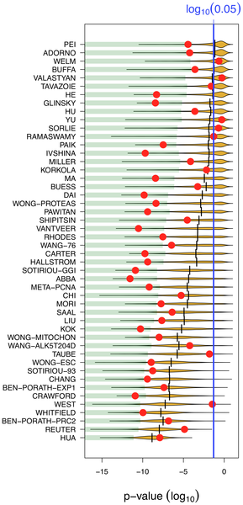
Most published signatures are not significantly better outcome predictors than random signatures of identical size
The x-axis denotes the p-value of association with overall survival. Red dots stand for published signatures, yellow shapes depict the distribution of p-values for 1000 random signatures of identical size, with the lower 5% quantiles shaded in green and the median shown as black line. Signatures are ordered by increasing sizes.
Venet D, Dumont JE, Detours V (2011) Most Random Gene Expression Signatures Are Significantly Associated with Breast Cancer Outcome. PLOS Computational Biology 7(10): e1002240. https://doi.org/10.1371/journal.pcbi.1002240
http://journals.plos.org/ploscompbiol/article?id=10.1371/journal.pcbi.1002240

Slide 25
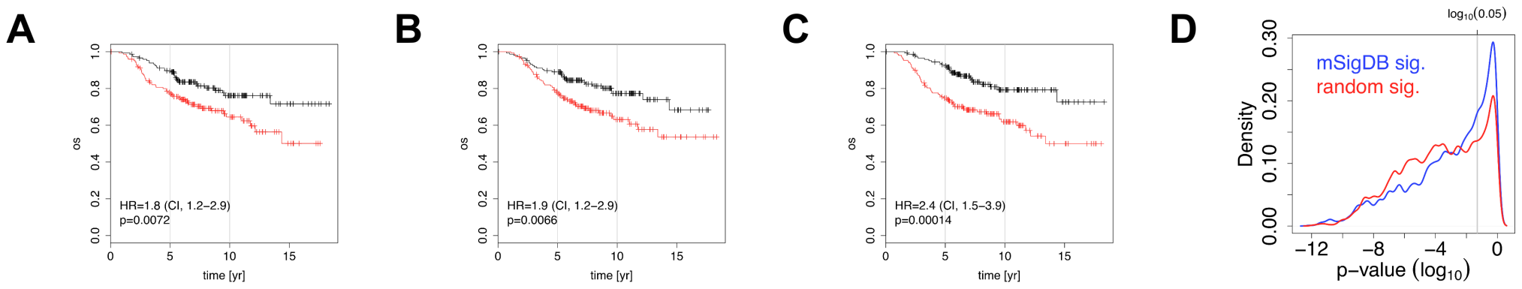
Association of negative control signatures with overall survival
In plots A–C the NKI breast cancer cohort was split into two groups using a signature of post-prandial laughter (panel A), localization of skin fibroblasts (panel B), social defeat in mice (panel C). In panels A–C, the fraction of patients alive (overall survival, OS) is shown as a function of time for both groups. Hazard ratios (HR) between groups and their associated p-values are given in bottom-left corners. Panel D depicts p-values for association with outcome for all MSigDB c2 signatures and random signatures of identical size as MSigDB c2 signatures.

Slide 26
Question:
Given that ~26% of the genes are related to survival at p<0.05, what are some approaches you can take to develop a robust biomarker of response that is independent of confounding factors such as ER status and proliferation?

Slide 27
Biomarkers

Slide 28
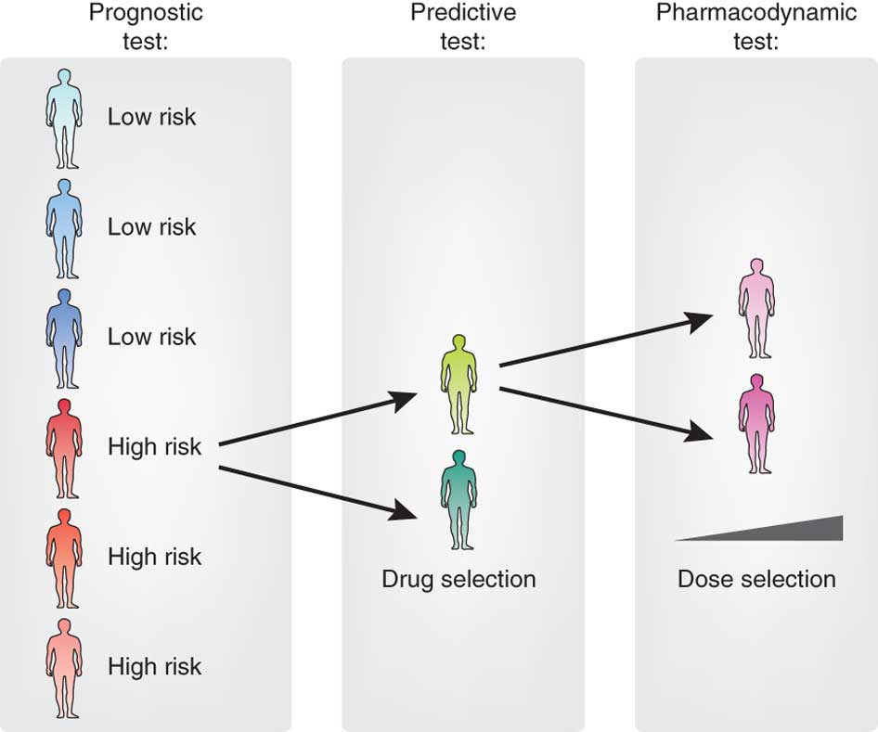
Biomarkers needed for a range of purposes
Also, biomarkers for pathway,
phenotype, tumor features

Slide 29
Gene, pathway, phenotype
HER2
(Receptor)
Outside
Inside
P
Tyr
P
Tyr
SOS
PI3K
PTEN
GTP
Survival
RAF
Ser/Thr
P
MEK
Proliferation
https://www.gene.com/stories/her2/

Slide 30
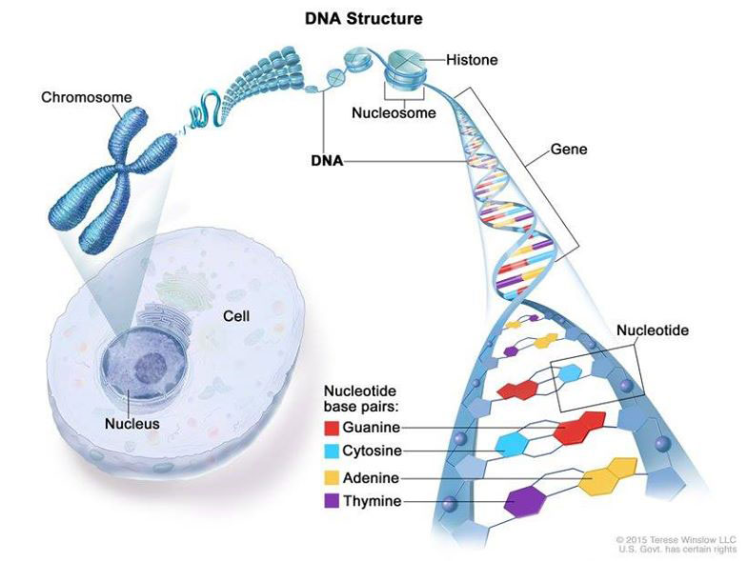
NCI.gov

Slide 31
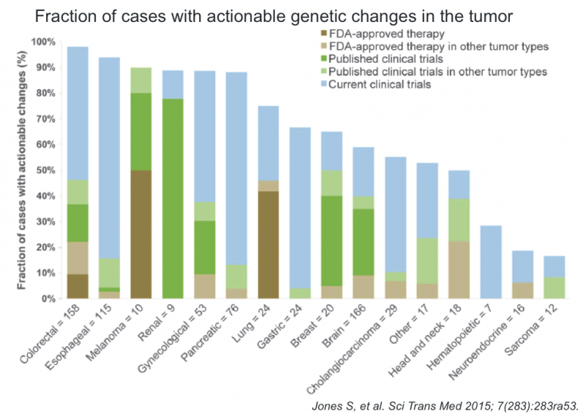
Do DNA-based tests provide actionable results?

Slide 32
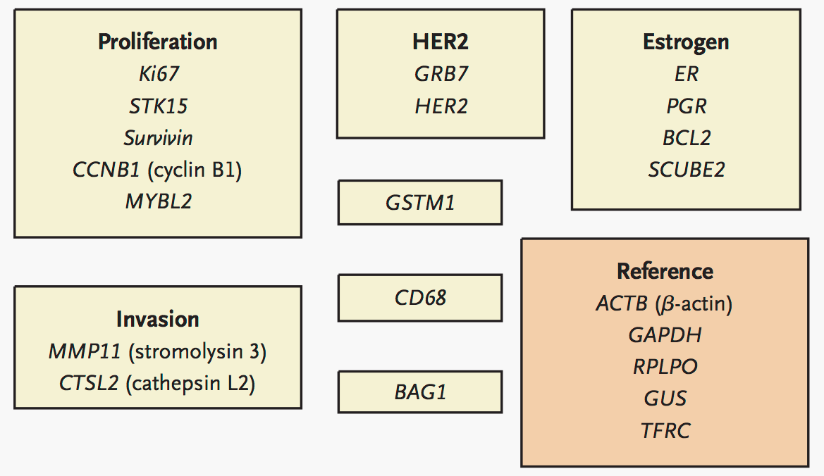
Oncotype DX: RNA based test
Paik et al., NEJM 2004

Slide 33
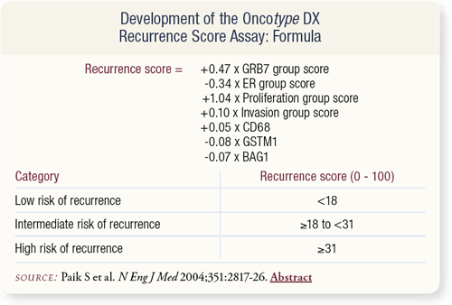

Slide 34
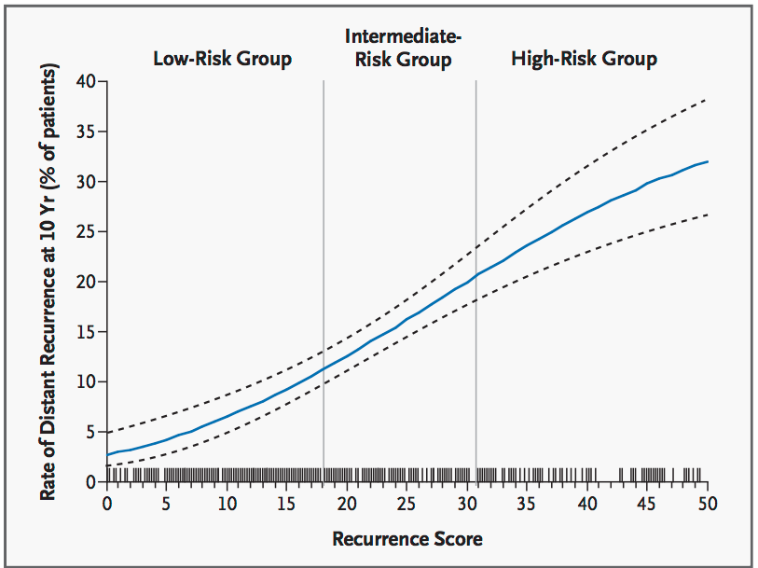
Recurrence Score Predicts Recurrence

Slide 35
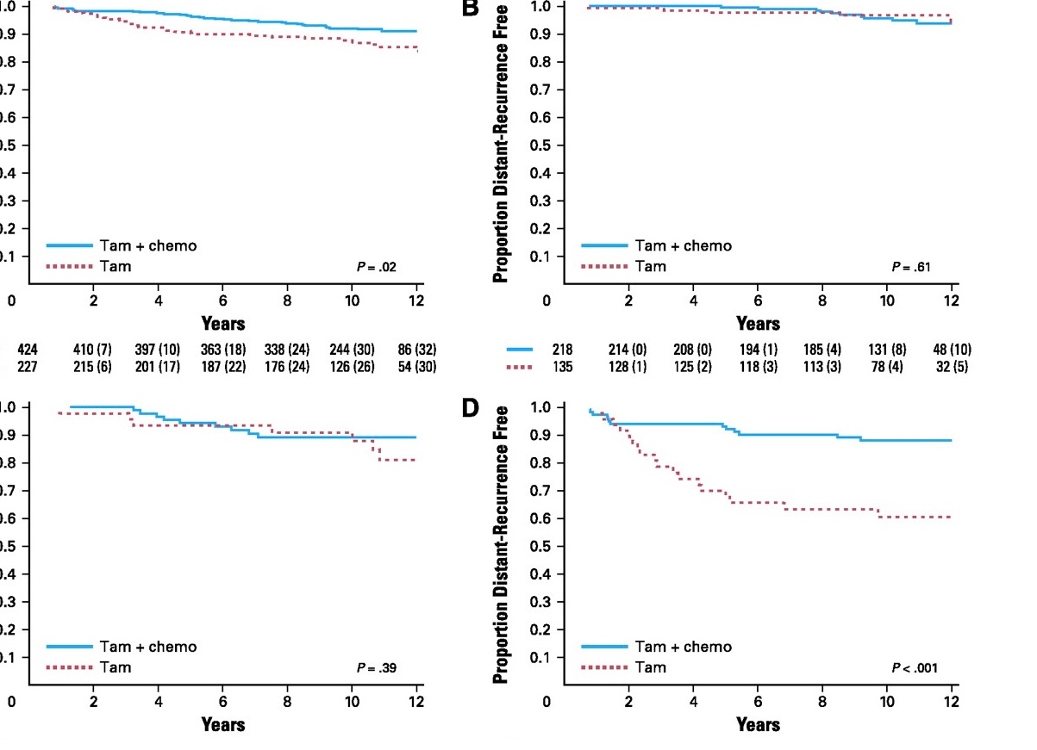
Biomarkers identify subpopulations that will respond to therapy
All patients
Low risk
Intermediate risk
High risk
Paik S et al., JCO 2006
Notes:
Kaplan-Meier plots for distant recurrence comparing treatment with tamoxifen (Tam) alone versus treatment with tamoxifen plus chemotherapy (Tam + chemo). (A) All patients; (B) low risk (recurrence score [RS] < 18); (C) intermediate risk (RS 18-30); (D) high risk (RS ≥ 31). The number of patients at risk and the number of distant recurrences (in parentheses) are provided below each part of the figure.

Slide 36
Question:
Oncotype Dx is a gene expression based biomarker of cancer recurrence and chemotherapy benefit. What other types of biomarkers may be useful?

Slide 37
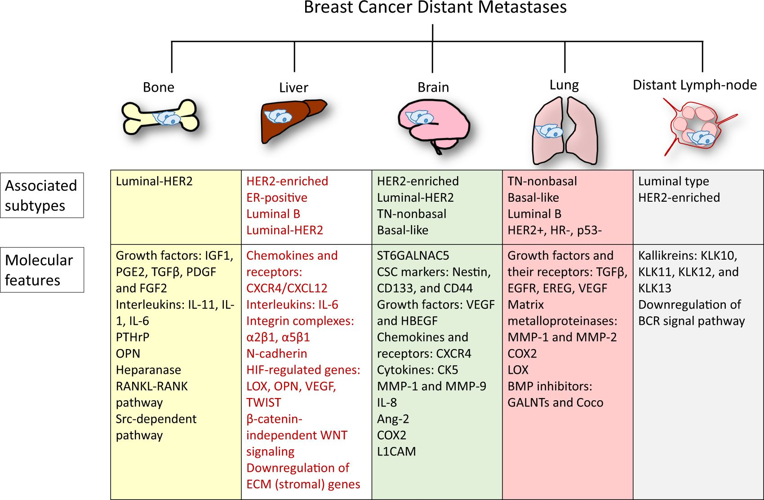
https://doi.org/10.1038/s41698-018-0047-0

Slide 38
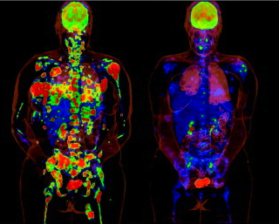
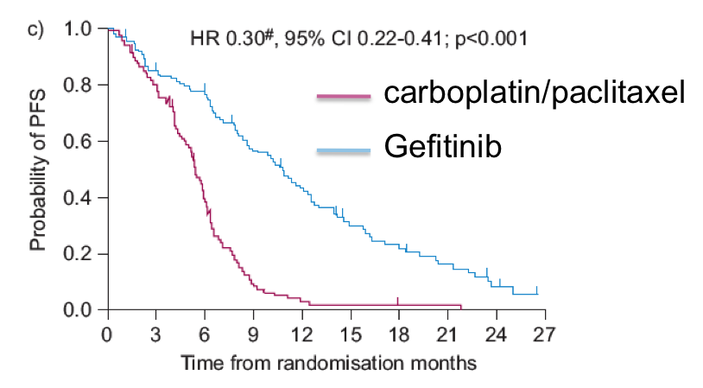
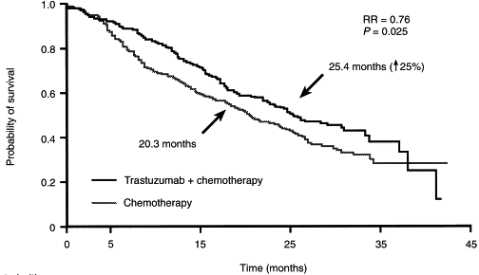
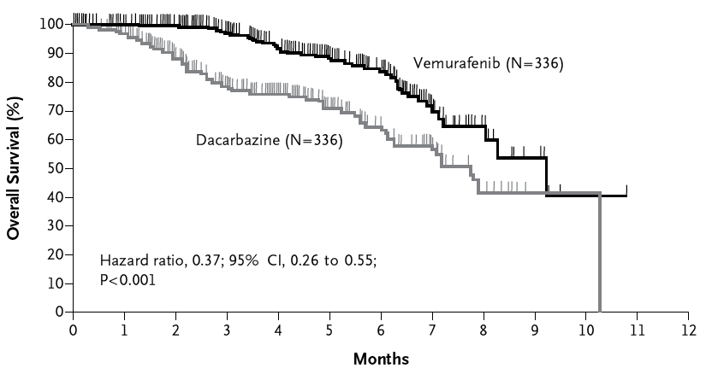
Targeted Therapies Improve Patient Outcome, But Often Fail to Cure Advanced Stage Cancer
Melanoma
Non Small Cell Lung Cancer
Gefitinib
Her2+ Breast Cancer
Trastuzamab
Vemurafenib
N Engl J Med 364;26 , 2011
European Journal of Cancer, Vol 37. Supp 1.2001

Slide 39
Question:
Why aren’t these drug regimens curing patients?

Slide 40


Tumor subclone heterogeneity and evolution
treatment
tumor heterogeneity evolves
each patient’s tumor has the potential for a unique evolutionary trajectory

Slide 41
SUMMARY
Genomic data can predict patient outcomes
Confounding variables are important to control for in complex datasets
Biomarkers related to tumor subtypes can predict drug response
Future efforts need to account for additional cancer features, such as heterogeneity and plasticity

Slide 42
Thank You!
Please contact me with questions:
abild@coh.org

Slide 43
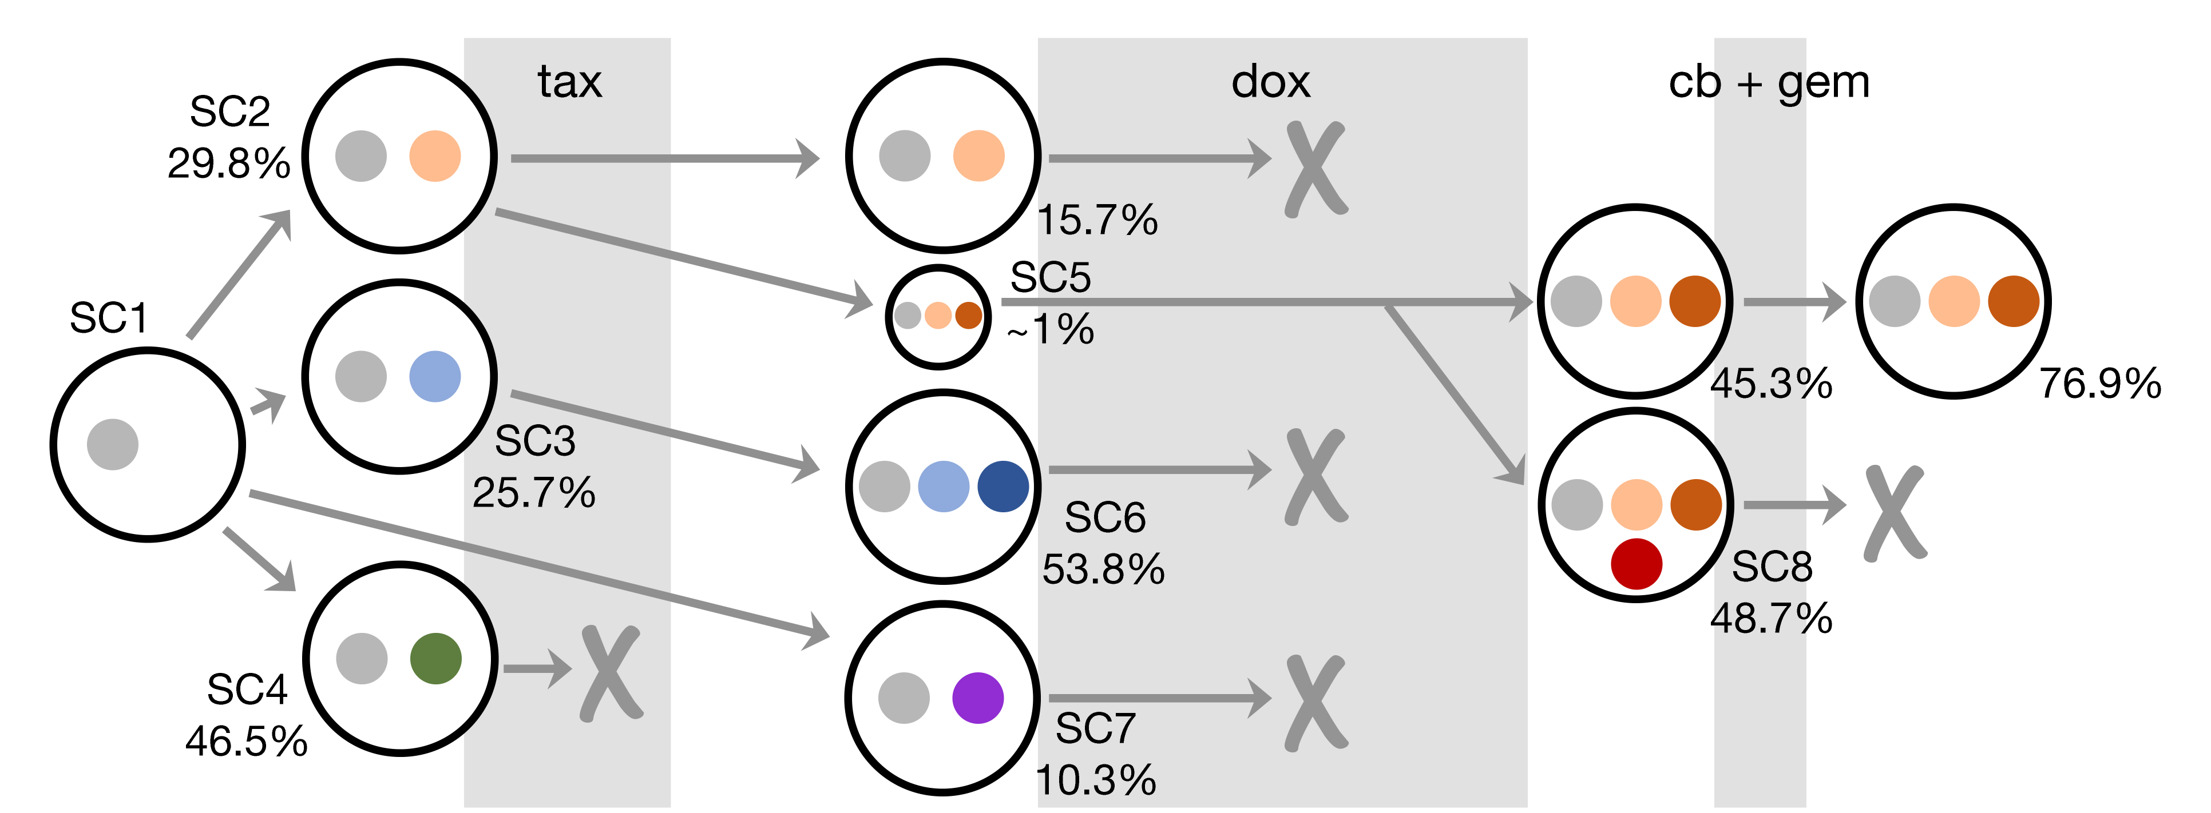
Longitudinal evolution of a breast cancer patient
= mutations present at every timepoint
Total of ~15000 variants, ~3,000 variants evolving over time (~26 total coding)

